Slide 1

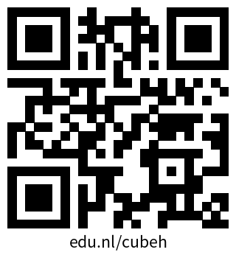
Polder Perspectives XR
Printing materials and instruction link for game hosts
Edu.nl/cubeh
Hosts, check speaker notes throughout this presentation for help and tips!

Slide 2

Polder Perspectives XR
Information Slide Deck

Slide 3

Welcome to Polder Perspectives XR
This is a workshop game that brings the ethical challenges of XR technologies in education to the table.
Through gameplay, it sparks debate around ethics and key public values.
But, what is Responsible XR?
Notes:
Host/Hostess:
Please check that you have printed all necessary material before starting the game.
Room advice: You will need space for teams to spread out and talk. Desks are helpful for players to draw on the canvases.
The goal here is to start the context of why the game is made and why we want to start the conversation on Responsible XR in education.

Slide 4

What is Responsible XR
Responsible XR
is about using and developing XR technology in a way that respects our public values.
We believe responsibility and responsible practices are possible by building this as a capability.
We believe technologies are not neutral, they change and impact how we relate to our education and research practices.
Notes:
Host/Hostess:
It is always welcome that you mention why this topic is important to you personally or why you find it important to discuss this within your institution/school.

Slide 5
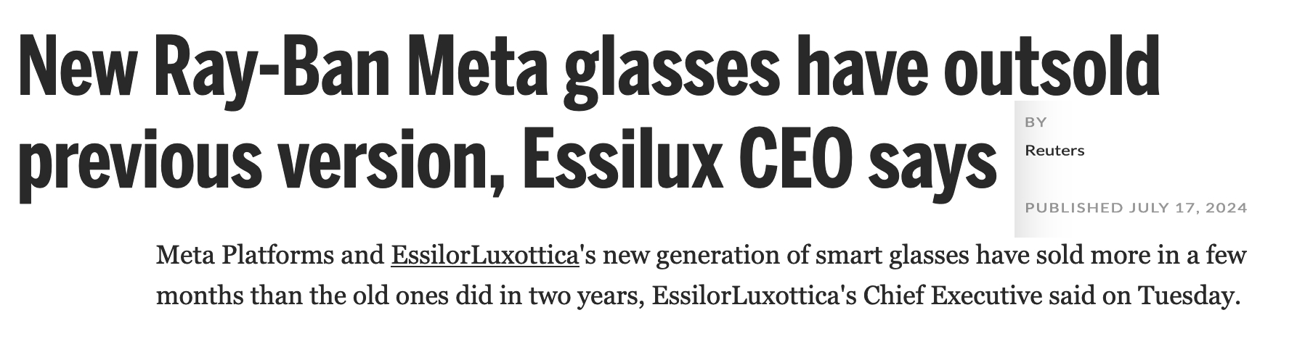
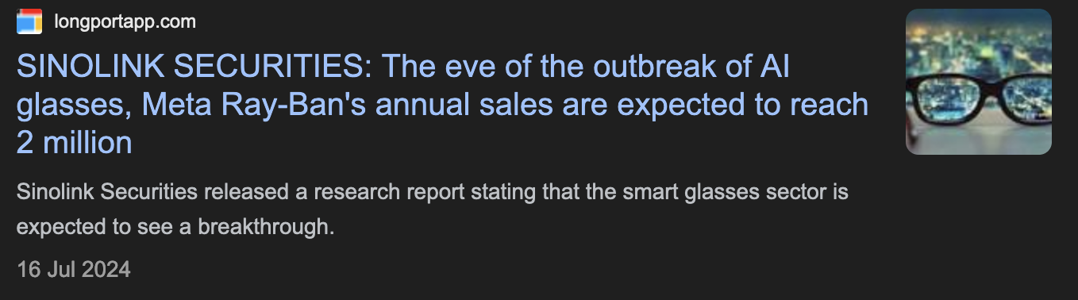
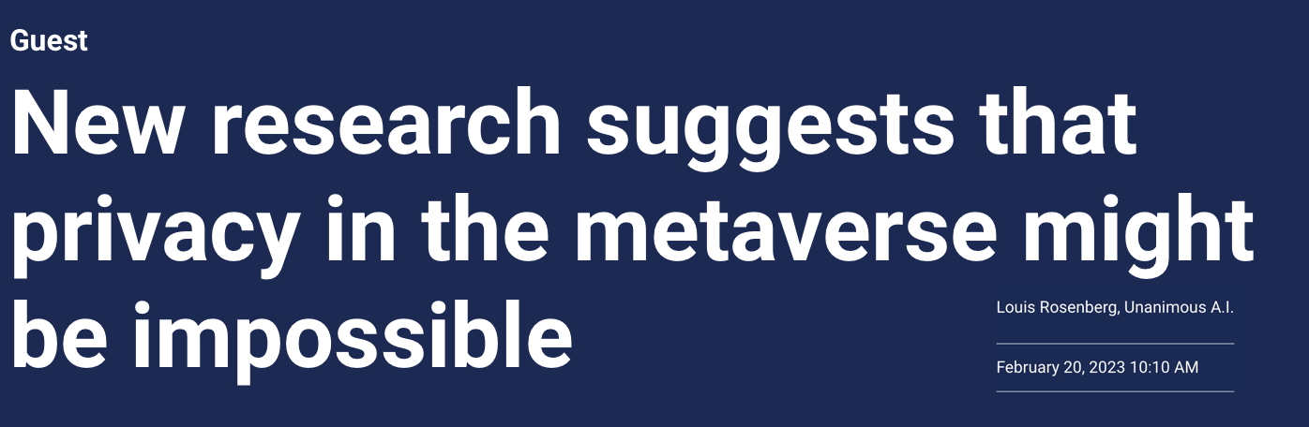
The time is now
The technologies we use are designed with values in mind, they are not only made for efficiency and practical sake.
Current technologies in XR and AI continue to develop quickly, often without recognition for social and societal impact.
We have a moment now, before mass adoption to have these conversations about reality-altering technologies in our institutions.
Notes:
Presentation notes:
Point 1: Technologies aren’t neutral—they reflect values beyond efficiency or productivity.
Point 2: XR and AI are advancing rapidly, often without considering societal impacts.
Point 3: Now is the time to discuss how reality-altering tech shapes our institutions before mass adoption.
//
Resources:
New Ray-Ban Meta glasses have outsold previous version, Essilux CEO says
https://ca.fashionnetwork.com/news/New-ray-ban-meta-glasses-have-outsold-previous-version-essilux-ceo-says,1650790.html
SINOLINK SECURITIES: The eve of the outbreak of AI glasses, Meta Ray-Ban's annual sales are expected to reach 2 million
https://longportapp.com/en/news/209060992

Slide 6
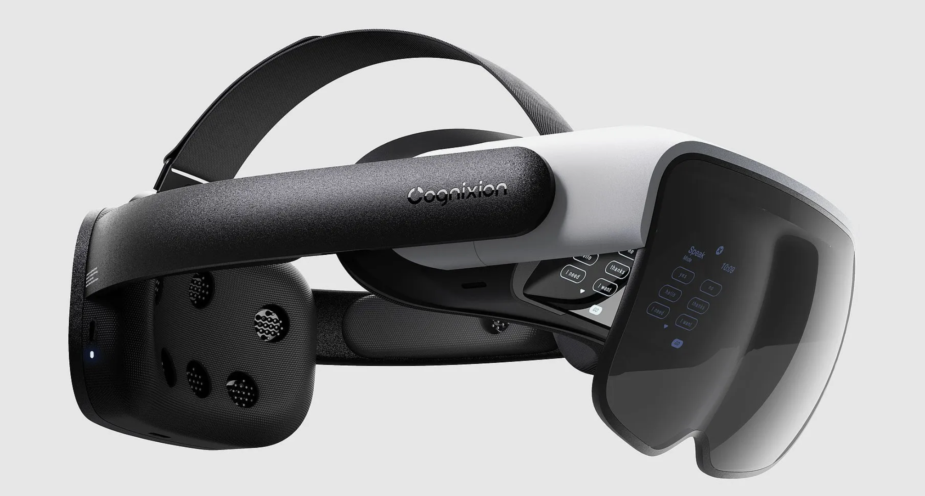

Looking forward, together
Future tech challenges
  Non-invasive brain-computer interfaces may redefine what we consider "normal" learner data.
Institutional awareness and discussion is needed
  As tech giants lead innovation, how should education adapt while safeguarding public values?
The Cognixion One: helping users with a wide variety of physical and neurological abilities to access augmented reality.
Even realities: G1 digital glasses
Notes:
Presentation Notes:
Technologies like the Cognixion One give us a glimpse into new possibilities for BCI and virtual information to be shared between user and interfaces.
These examples reveal new ways in which we interact with bioinformation, and offer ‘food for thought’ of how we might view the future of this information in educational use.
AI and XR will continue to develop together and in unexpected ways.
Resources:
More information on BCI for VR/AR/XR — 2023
https://medium.com/@re-ak/bci-for-vr-ar-xr-review-2023-68c4faafbbae
Even Realities G1: https://www.4doptiek.nl/nieuws/2013155_slimme-bril-even-realities-g1-digital-glasses

Slide 7
Ambition
So, how can we do more?
Let’s learn together, today.

Slide 8
What is planned?
Reflect on our shared public values
Play unfamiliar roles
Make new XR experiences
Ask and (try to) answer hard questions

Slide 9
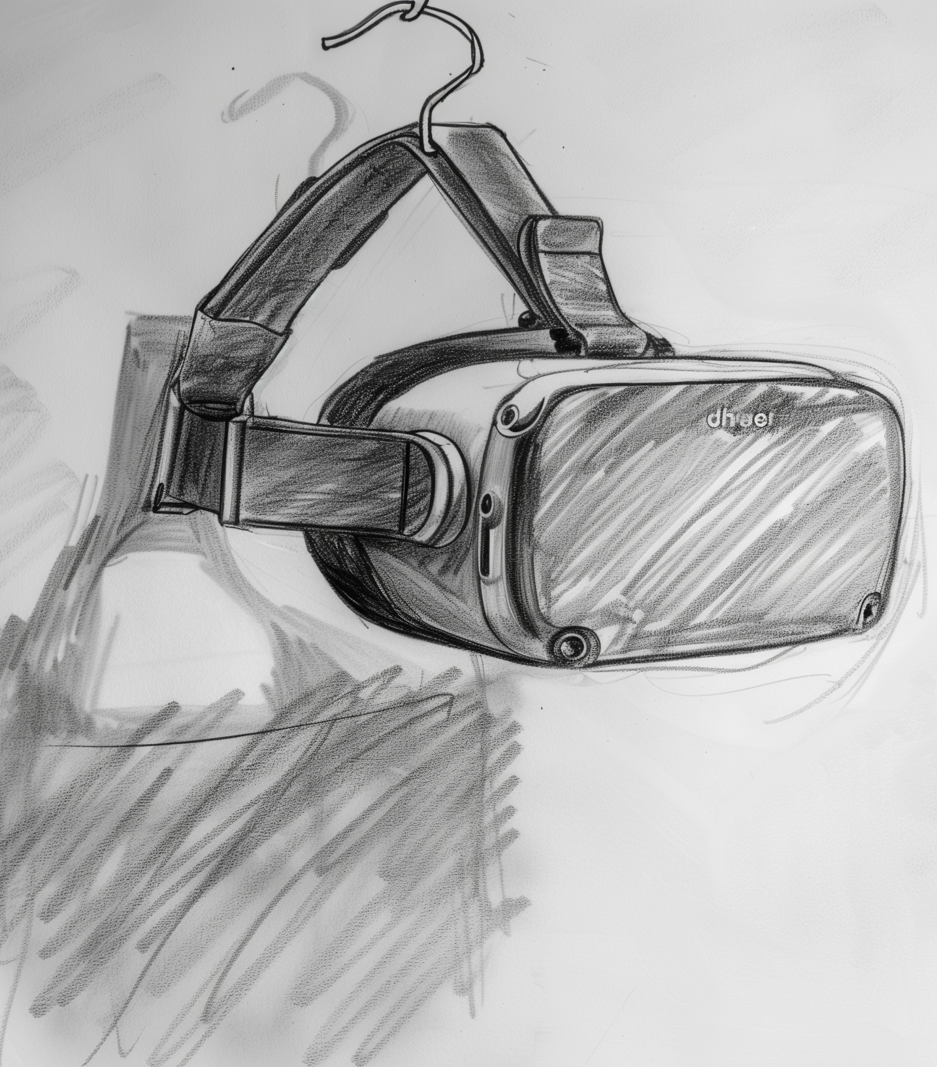
What are we doing?
Goal
  This workshop is intended to experience how ethics within XR and education can come together. It is a starting point to become more aware of ethical issues and how you could deal with them in your own practice.
Reflection
  What did you notice during the workshop?
  How could you make ethical issues more discussable in a project in the future?
Notes:
Learner Slide
For audience of students or new learners that will need more time to consider the concepts we will discuss in the game. For audience that have less use for other tools or ‘next steps’ after the game in their work.
Slide voor leerlingen
Voor studenten of nieuwe leerlingen die meer tijd nodig hebben om na te denken over de concepten die we in het spel bespreken. Voor een publiek dat minder gebruik maakt van andere hulpmiddelen of 'volgende stappen' na het spel in hun werk.

Slide 10
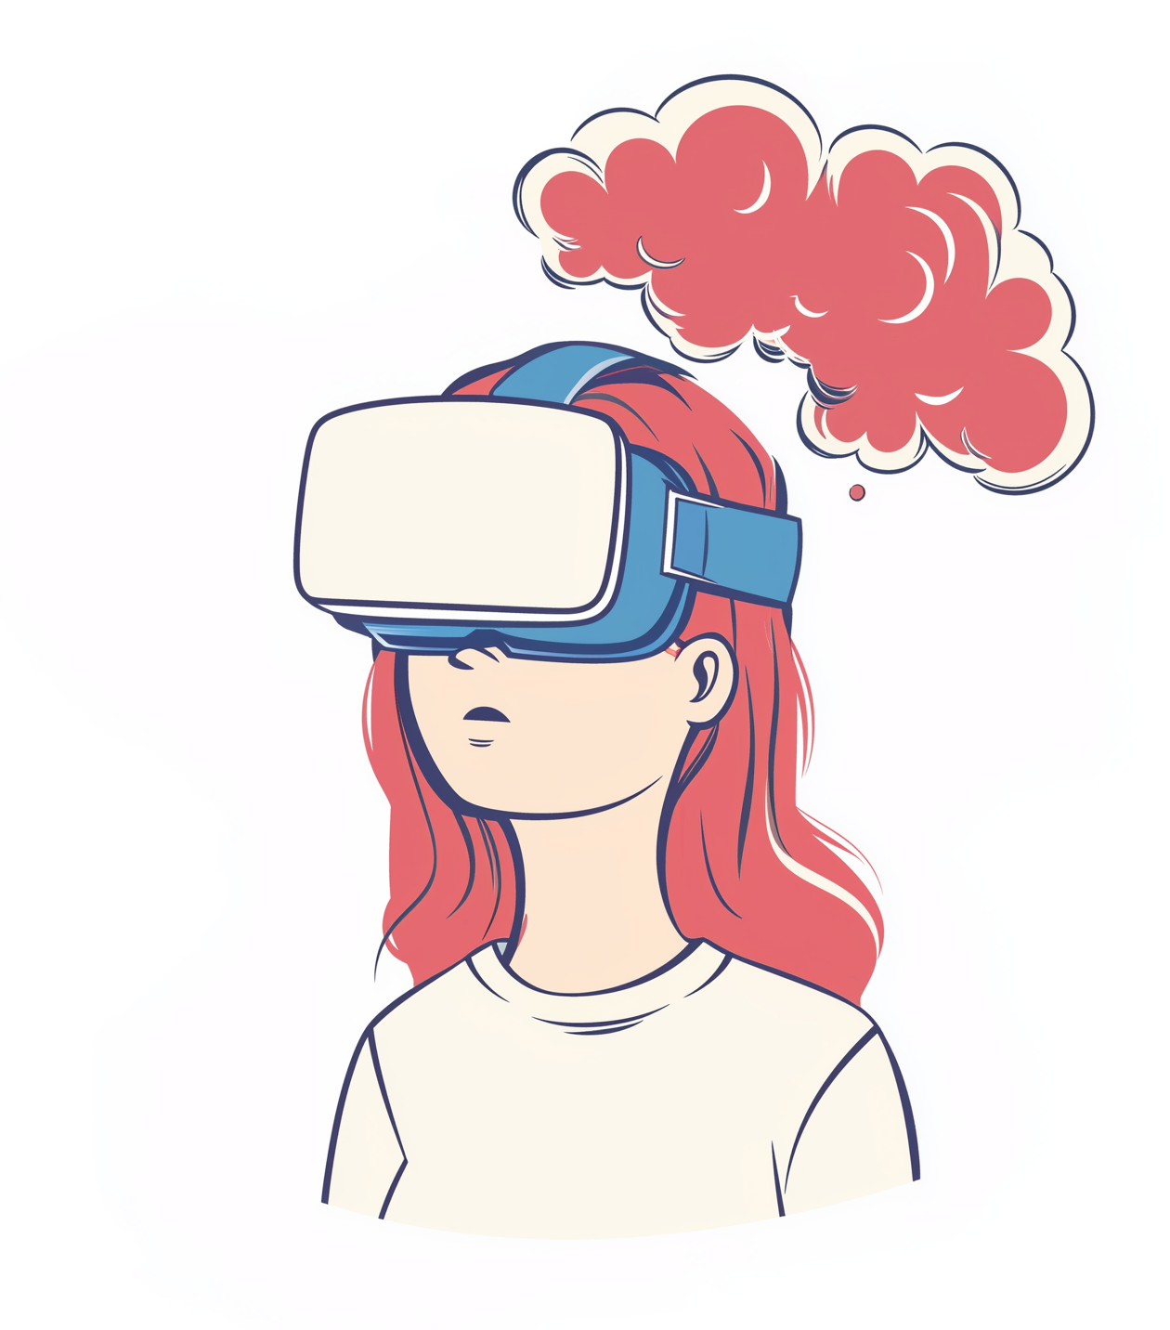
Let’s consider values
What Are Values?
Values are the principles and priorities that shape how we think, act, and make decisions.
Values help guide what we believe is important—both in life and in technology.
When we talk about XR in education, values help us ask:
What should this technology protect or promote?
Is this safe for students?
How do we balance innovation with ethical concerns?
Now, take a moment to think about your own values before we begin.

Slide 11
Personal Values Phase – 5 Min
Grab a Player Profile Sheet
  From the Value Compass (next slide)
Fill in your top three values you find important for XR in education.
Place a question you want to answer by the end of the workshop about XR in education.
Notes:
Note: Consider to take time for people to introduce themselves briefly to each other and express their big question after they written it down in their profile sheet.

Slide 12
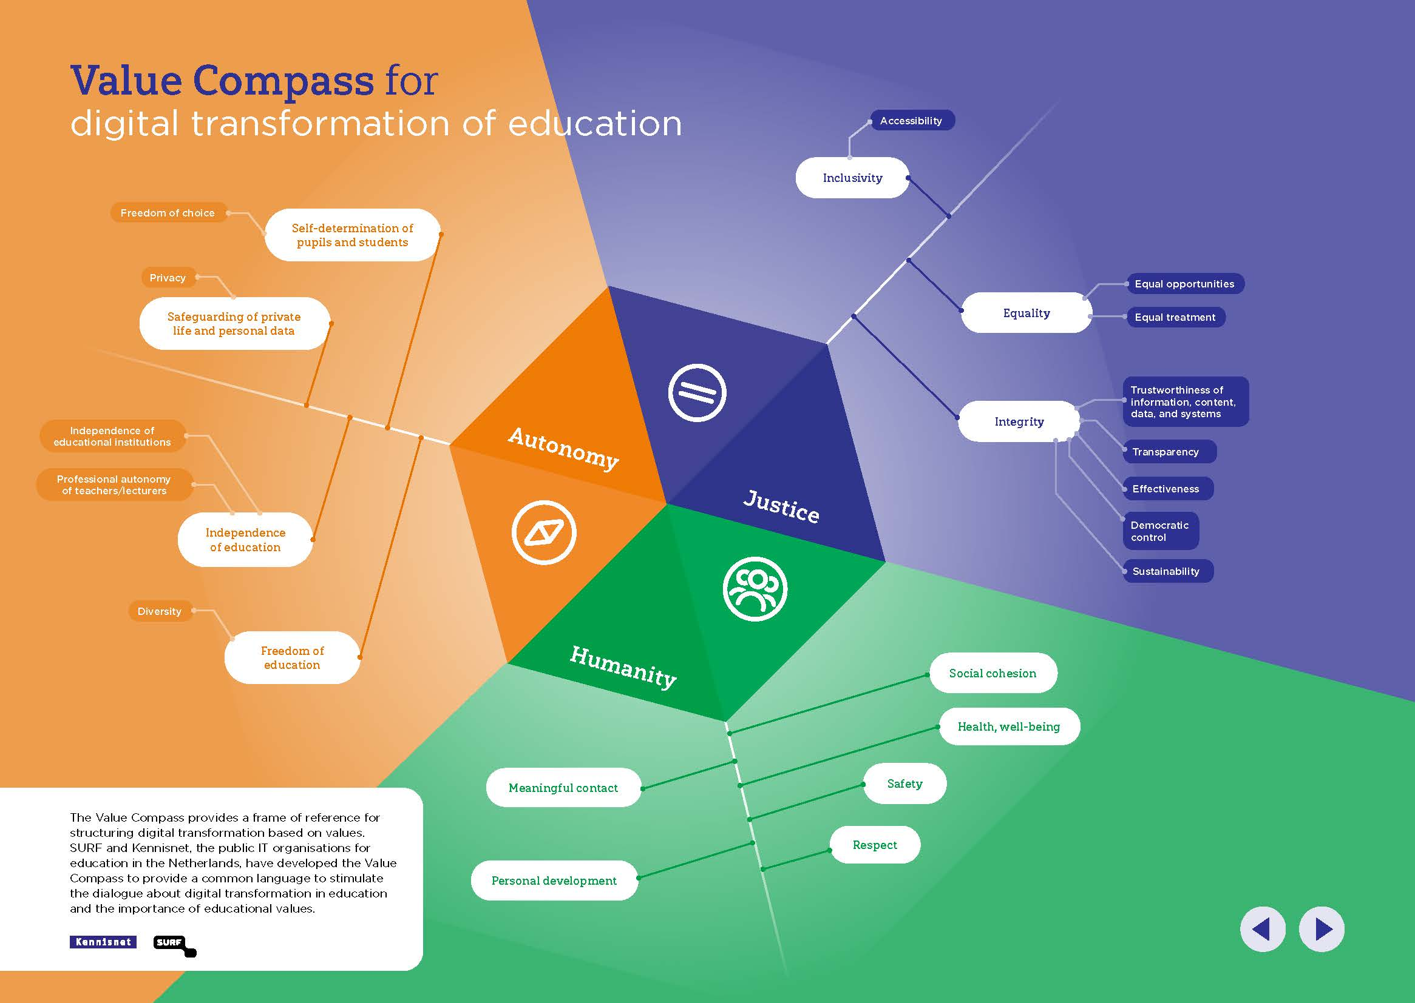
Need help with the values?
Notes:
Presentation notes:
These values are shared by our member institutions, but there are many more possible values to consider in the future of digitalisation!
Use this tool as a shared value bank, or bring your own!
Link to value compass: https://www.surf.nl/themas/publieke-waarden/waardenwijzer

Slide 13


Put the personal profile sheet away for now.
Save it for later.
Notes:
Note: Consider to take time for people to introduce themselves briefly to each other and express their big question after they written it down in their profile sheet.

Slide 14

Group Phase – 3 Min
Form Groups of 4 or 5 people
Take 1 Company card
Read the company card to your team.
  Start with ”We work at…”
Notes:
Presentation notes:
Gather players around tables or parts of the room.
Pass out the company cards.
Give them some time to read the cards. Prepare the role cards.

Slide 15
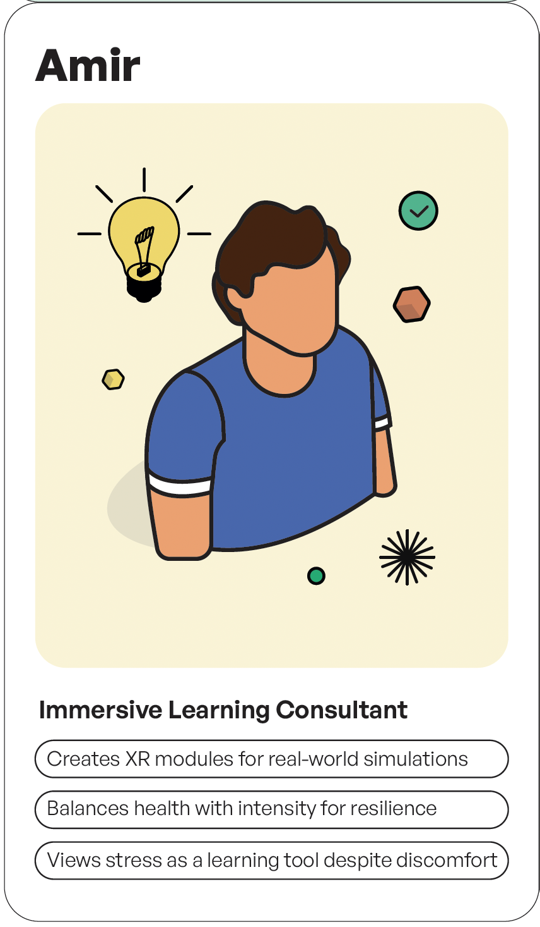
Group Phase – 5 Min
Game host: Pass out Role cards
Share your role with the others in your company
  Be sure to say your role
  Share what your character believes in
Notes:
Presentation notes:
Pass out role cards.
Give time for players to read and discuss or ‘become’ their role.

Slide 16
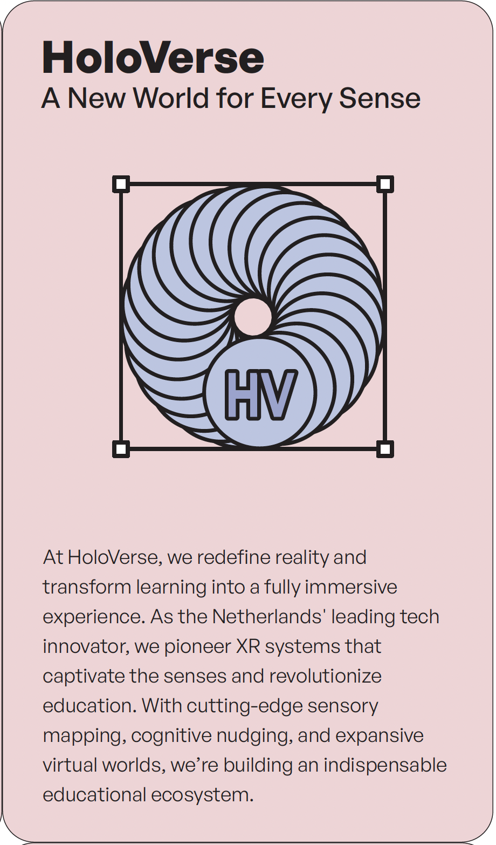
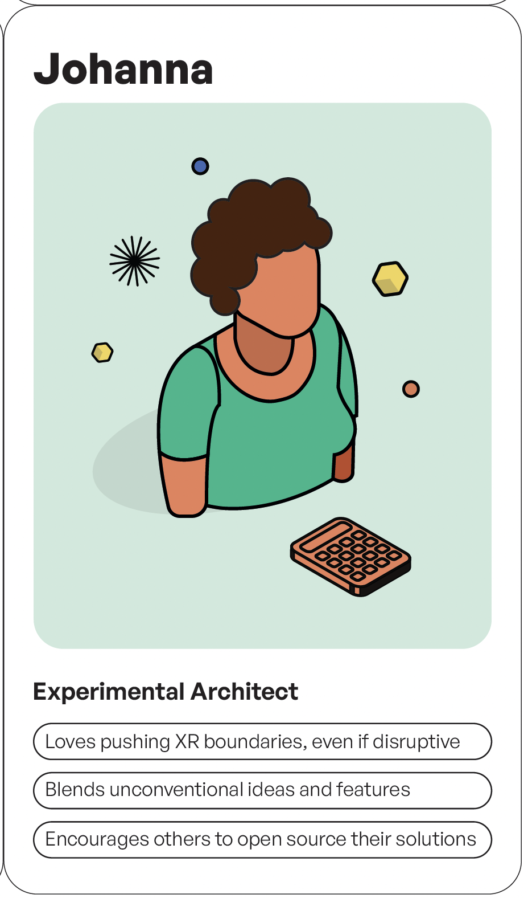
This is your team.
Polder Perspectives XR is a role-playing game.
Companies have their own values they put into their products.
Everyone plays a role in a company.
Step into this company to solve the assignment with different goals than you may be used to.
Step into this role to help shape a product with someone else’s values in mind.

Slide 17

Group Phase – 5 Min
Game host:
  Pass out Your Concept Canvas
  Share Assignment
Both groups get the same assignment / case
  Companies will prepare a solution and a pitch for the given assignment
Notes:
Presentation notes:
Give time to read assignment for all companies.
Reading the assignment can help with larger groups.
Commenting what is intersting or unique about the assignment may help newer players think along.
Prepare canvases to be passed out during or after the assignment is read.

Slide 18



Your assignment
All companies will receive the same assignment.
Clients can have new concerns that come up during the development process of a solution.
Your company will have to pitch their solution to the client.

Slide 19
Ambition
Assignments Phase

Slide 20
Assignment
Wandering Eyes
We need an XR solution to monitor students during exams using facial recognition, pupil scanning, and behavior tracking to prevent cheating. The system should detect suspicious behavior while balancing test integrity with respect for student privacy. How can we ensure that tracking adds real value to the exam process?
What we need from you:
Use facial recognition or eye tracking, ensuring explicit student consent.
Limit biometric tracking to behaviors directly related to exam integrity.
Include monitoring assistance tools that support educators in real time.

Slide 21
Assignment
Crime Scene Simulator
We need a realistic crime scene simulation where students can investigate criminal cases. The experience must be immersive, respectful of privacy, and avoid using any sensitive or real-life details. How might we involve individuals with past criminal experience in the development process, or the police, to enrich the learning experience?
What we need from you:
Use hand tracking to allow students to handle evidence.
Incorporate voice recognition for simulated interrogations.
Implement LiDAR technology to accurately map crime scenes.

Slide 22
Assignment
Virtual Hospital
We want to create a realistic medical simulation where students can diagnose and treat virtual patients, allowing them to experience high-pressure situations without overwhelming stress. The environment should adjust to each student's learning pace and incorporate anonymized real patient data to ensure privacy. What unique or high-risk situations should we introduce to challenge learners effectively and safely?
What we need from you:
Include hand tracking to simulate physical exams and procedures.
Use voice recognition for doctor-patient interactions.
Implement eye tracking to assess focus and responsiveness.

Slide 23

Assignment
Critical Care Simulator
We need an immersive experience where students can practice high-risk medical procedures, such as trauma care, in realistic, life-or-death scenarios. The simulation should balance intense realism with ethical boundaries to avoid overwhelming students, ensuring they learn effectively without unnecessary stress. What specific, high-stakes situations could push students to develop resilience and decision-making under pressure?
What we need from you:
Include hand tracking to simulate physical and surgical procedures.
Use voice recognition to enable realistic doctor-patient interactions.
Ensure real patient data is fully anonymized to protect privacy.

Slide 24
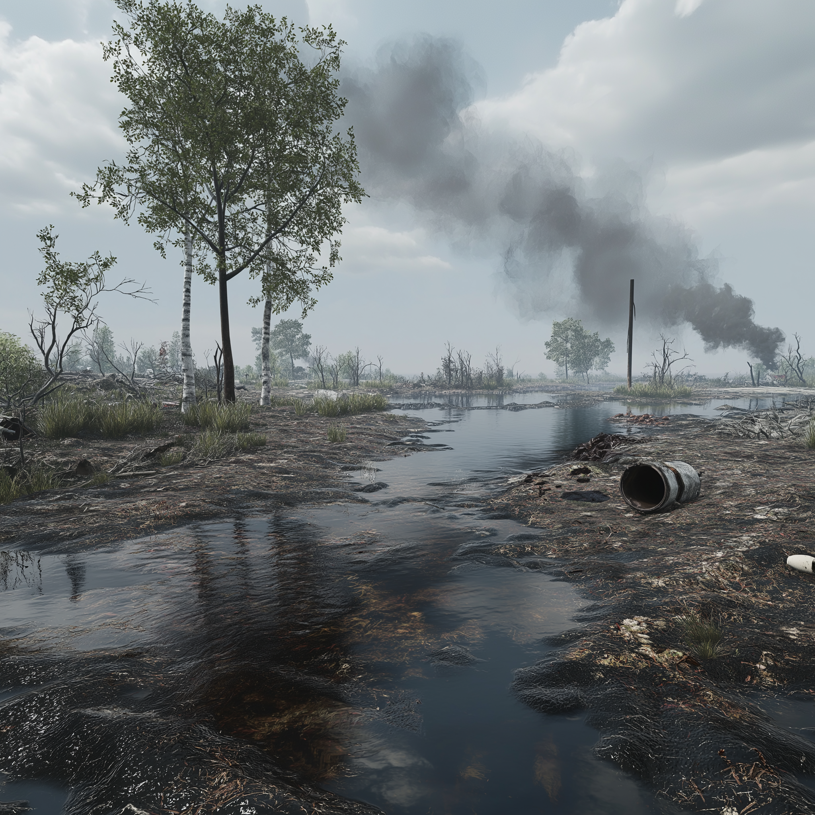
Assignment
Environmental Disaster
We want to create an augmented experience where students can explore environmental disaster zones, such as oil spills or deforested areas. The simulation should immerse students in the environmental impact without overwhelming them, while making the learning goals explicit. How can we design these environments to create an emotional connection to distant communities?
What we need from you:
Use body tracking for interaction with elements of damage and recovery.
Implement voice recognition so students can ask questions and navigate the simulation.
Include guides for students in new areas

Slide 25

Assignment
Building the past
We need an immersive XR experience for archaeology students to explore the ruins of a Roman-era trading hub in North Africa. The simulation should teach students to analyse artifacts and understand how historical narratives are shaped by those who interpret them. Students should also reflect on the ethical challenges of presenting history in ways that respect all cultural perspectives.
What we need from you:
Use interactive features like artifact restoration or recreating daily life scenes.
Incorporate features that are sensitive to cultural conflicts and differing interpretations.
Add accessibility options for visually impaired students to ensure inclusivity.

Slide 26
Concept Phase –
15 Min
Now we need to brainstorm a solution to this assignment.
Grab and fill in Your concept canvas to help structure your idea.
Brainstorm first and share first ideas.
Don’t forget to write on the canvas!
Notes:
Presentation notes:
Consider how much time to give teams for this phase.
Remind teams during the phase to fill in canvas.
When the XR concept canvas is at least half filled for a team, give them an ethical lens card to improve their concept.

Slide 27
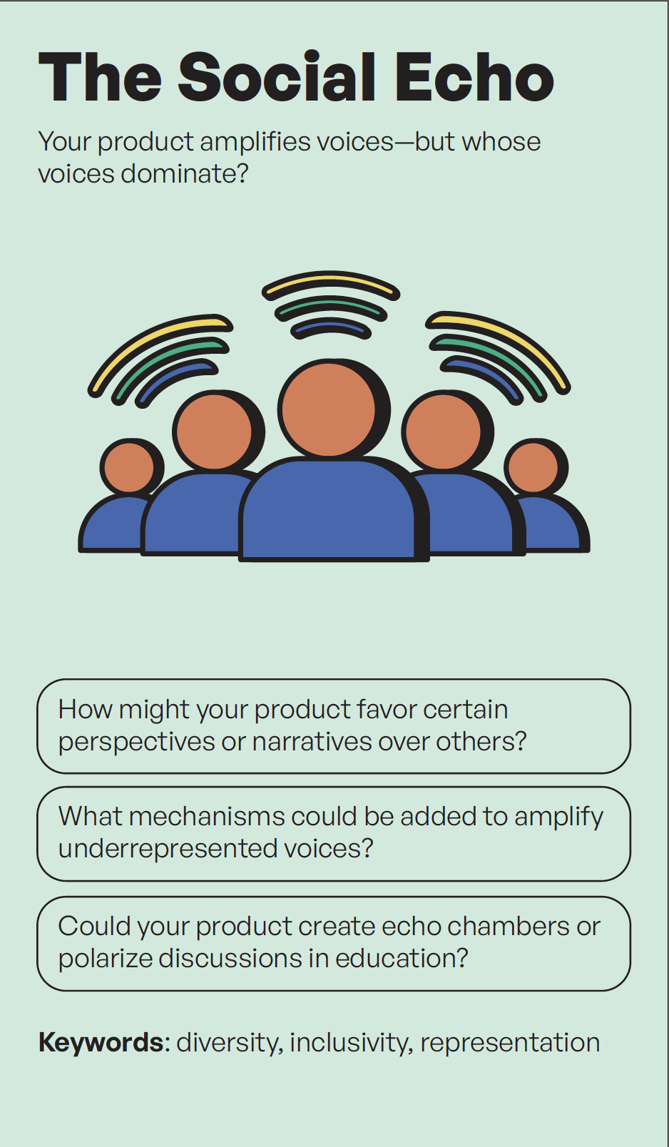
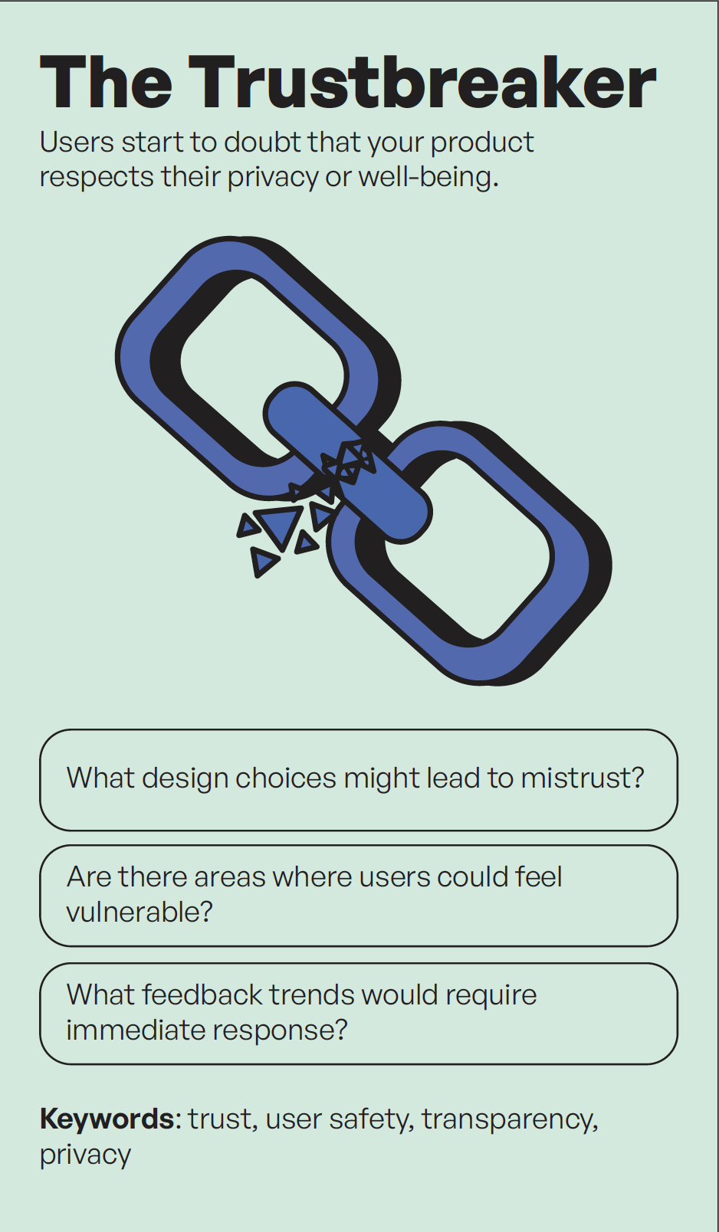
Lens Check Phase – 10 Min
Grab 1 Ethical Lens card
Read a question to your group
Look through the ethical lens cards and evaluate if your concept has considered this value or concern.
  Improve your concept with this;
  make it stronger!
Notes:
Presentation notes:
When the XR concept canvas is at least half filled for a team, give them an ethical lens card to improve their concept.
Option: You can offer the lens cards as ”new concerns coming from the client” if they don’t know how to contextualise the card.
Have players read the lens cards out to the team, one question at a time.

Slide 28
Lens Card Example
Scenario: You’re creating an XR training app for healthcare students.
Value in concern: Accessibility
How accessibility may shape your design:
With Accessibility
Your solution may include voice commands, adjustable text sizes, and options for colour-blind users.
Without Accessibility
Your solution may only rely on visual cues and small text, leaving some users struggling to participate.
Think about:
What features would make your solution more inclusive?
What might you sacrifice to make it accessible for more users?
Notes:
Presentation notes:
When the XR concept canvas is at least half filled for a team, give them an ethical lens card to improve their concept.
Option: You can offer the lens cards as ”new concerns coming from the client” if they don’t know how to contextualise the card.
Have players read the lens cards out to the team, one question at a time.

Slide 29
Pre-evaluation Phase
Grab your Player profile sheet remind yourself what you wrote
Prepare to evaluate a pitch based on your own public values choices.
  i.e. not your role card
Notes:
Presentation Notes:
Hava players grab their personal profile sheets they filled out at the beginning of the workshop.
We are looking for value alignment based on this sheet.
Action: A company will pitch their solution, the listeners will need to review their solution via the personal profile sheet.
-- If you have multiple companies, have one company review another, not all companies on one solution.

Slide 30
Review your personal profile sheet – 2 Min
Grab your personal profile sheet remind yourself what you wrote.
What values did you find important that were different from your role in the company?
Write your values down on the
XR Project evaluation sheet.
Notes:
Presentation Notes:
Hava players grab their personal profile sheets they filled out at the beginning of the workshop.
We are looking for value alignment based on this sheet.
Action: A company will pitch their solution, the listeners will need to review their solution via the personal profile sheet.
-- If you have multiple companies, have one company review another, not all companies on one solution.

Slide 31




Present Phase - 5 Min per group
Pitch your concept to the group
  Use your Your Concept Canvas to help!
Audience Role
  Take out your personal value canvases. Keep it nearby
  Grab 1 ethical lens card for your group to ask the presenter
Notes:
Presentation Notes:
We are looking for value alignment based on this sheet.
Action: A company will pitch their solution, the listeners will need to review their solution via the personal profile sheet.
If you have multiple companies, have one company review another, not all companies on one solution.
Another ethical lens card should be used from the team assessing the presenting company, please give them a new lens card or use the same one they had before.

Slide 32
Evaluation Phase
Grade based on your own
personal profile sheet
Solution completeness
Alignment to your values, based on top 3 values on personal profile sheet, scale 1-5.
Notes:
Presentation Notes:
Action: Collect these evaluation sheets and have players take a small break. Count up the points to deem a ‘winner’ for the session. Give room for deliberation and reflection by the players.
Make note of what you found interesting for both company solutions and any ethical or public value ‘red flags’ you noticed.

Slide 33
Break
10 Minutes

Slide 34
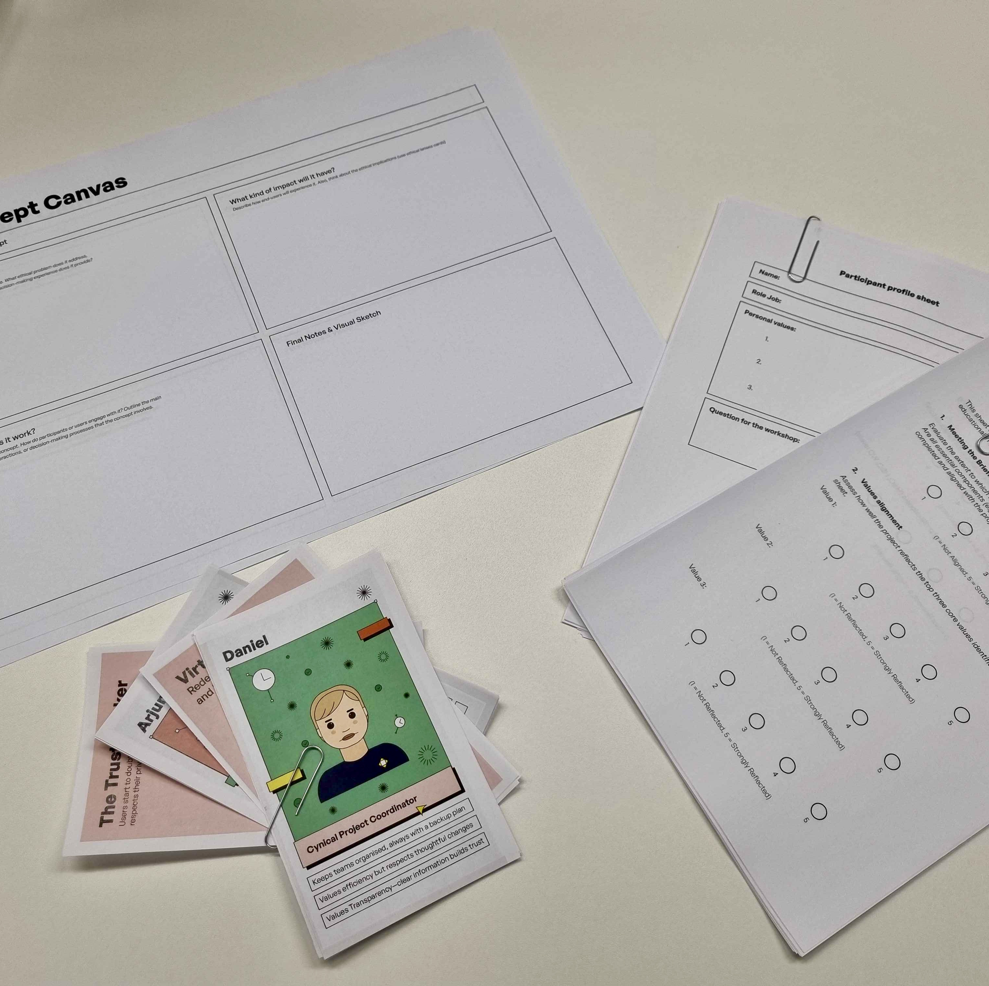
Evaluation Phase
Review scores
Let’s determine a winner!

Slide 35
What are we doing?
Goal
  This workshop is intended to experience how ethics within XR and education can come together. It is a starting point to become more aware of ethical issues and how you could deal with them in your own practice.
Reflection
  What did you notice during the workshop?
  How could you make ethical issues more discussable in a project in the future?
Notes:
Learner Slide – Reminder at the end to use this slide again!
For audience of students or new learners that will need more time to consider the concepts we will discuss in the game. For audience that have less use for other tools or ‘next steps’ after the game in their work.
Slide voor leerlingen - Herinnering aan het einde om dit opnieuw te gebruiken!
Voor studenten of nieuwe leerlingen die meer tijd nodig hebben om na te denken over de concepten die we in het spel bespreken. Voor een publiek dat minder gebruik maakt van andere hulpmiddelen of 'volgende stappen' na het spel in hun werk.

Slide 36
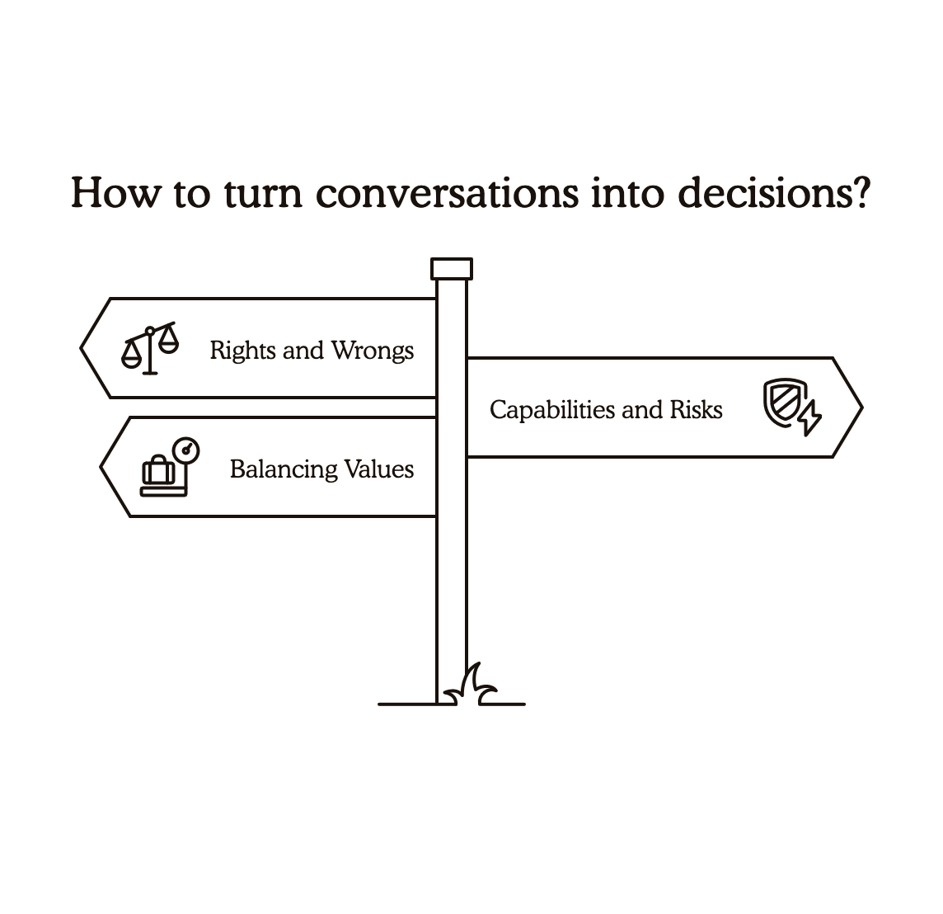
Let’s use: The Decision Making and Value Weighing Sheet
Introduction
  We have had a lot of conversation about:
    Rights and wrongs
    Capabilities and risks
    Balancing or weighing values
  Now we’d like to help you turn these conversations into decisions for your institution!
Notes:
The Decision Making and Value Weighing Sheet is targeted towards audiences and players of decision-making roles in institutions. It may also be helpful for educators and information managers who find themselves in decision-making scenarios/roles.
Host notes:
Introduce the decision making sheet and why you find it valuable for your players.

Slide 37
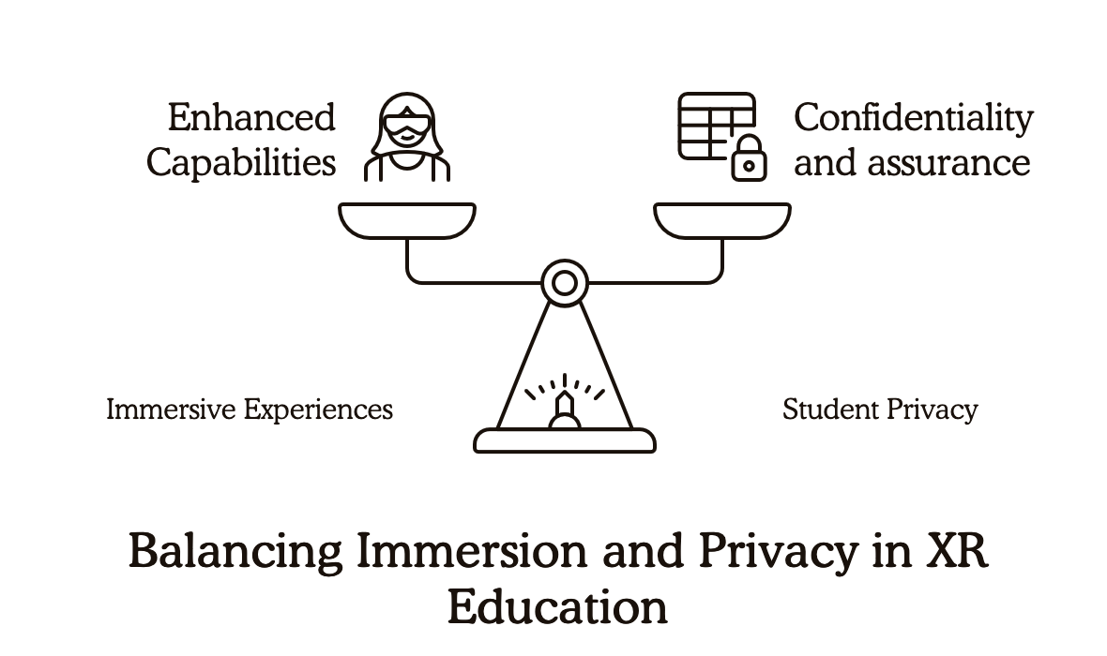
Decision Making and Value Weighing Sheet
Host/hostess
  Pass out the
  Decision Making and Value Weighing Sheet to all players.
Players
  Review Section 1
  Do this by yourself or with a partner from your table.
Tip for players
  Be specific in identifying the two values that were at odds, as this will help you better understand the trade-offs.
Example model of value weighing
Notes:
Host notes:
Ask participants to think about an XR decision they faced in the game.
Prompt them to identify two values that seemed to be in conflict in that decision.
Have them write those two values in the spaces provided.
Then, ask them to reflect on how this value conflict changed the way they thought about the decision.
Encourage participants to share their examples and insights with the group.

Slide 38
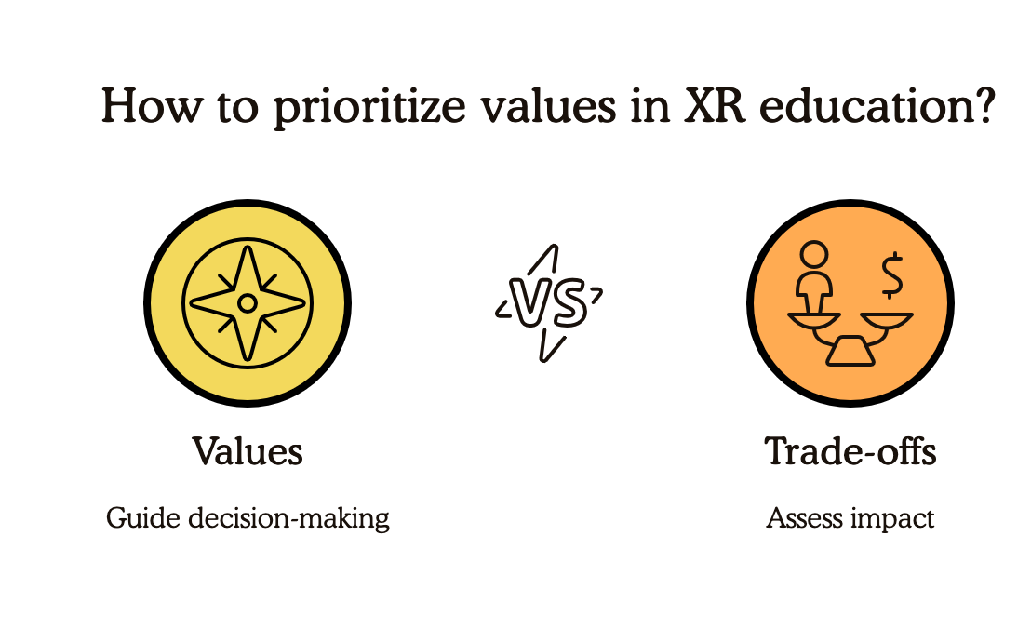
Section 2: What Do We Gain? What Do We Lose?
Players
  Move to section 2
Every decision has trade-offs.
  Choosing one path usually means giving up something else. Look at the values you listed above.
Tip
  Consider the positive outcomes if you had prioritized Value 1, as well as what you would have had to sacrifice or compromise.
Notes:
Host notes:
Remind participants of the two values they identified on the previous slide.
Ask them to consider what would improve and what might suffer if they prioritized each of those values.
Have them fill in the "Benefit" and "Loss" sections for each value.
Emphasize that no decision is perfect, but thinking through these trade-offs can help make more intentional choices.

Slide 39
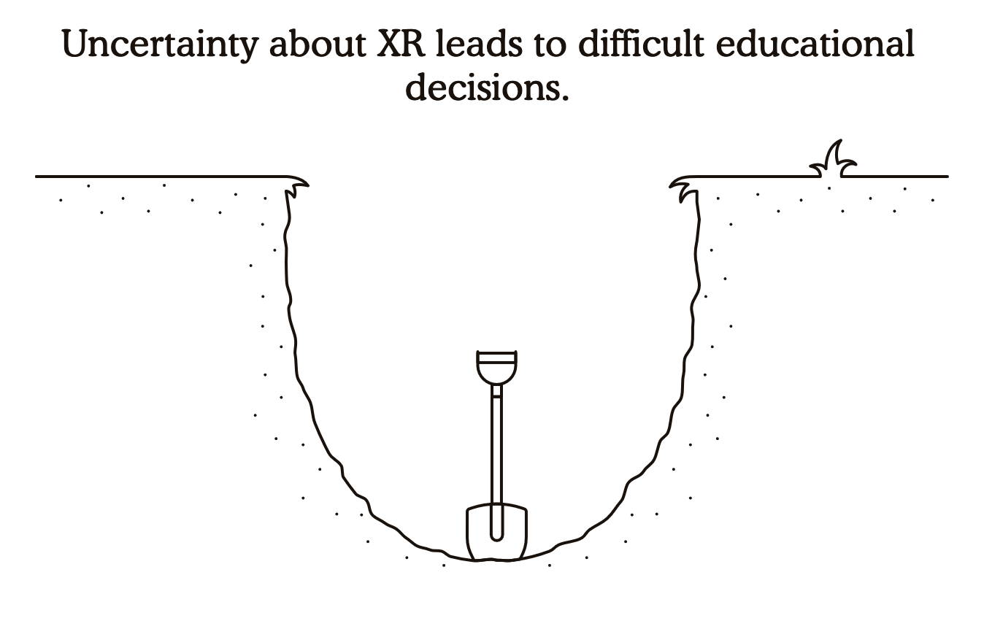
Section 3: What’s the Next Decision That Matters?
In your work, the real questions don’t stop when this game ends.
Your institution will face new choices about XR in education.
Tip:
  Consider which stakeholders (e.g., faculty, students, IT, administration) should be involved in making this decision and why their perspectives are important.
  Brainstorm an action you can take to ensure the decision-making process is thoughtful, inclusive, and aligned with your institution's values and priorities.
Notes:
Instructions for the workshop lead:
Ask participants to think about the next decision their institution will face regarding XR in education.
Have them describe that decision in the space provided.
Prompt them to consider the trade-offs that will come with that decision and write them down.
Then, ask them to identify who else should be involved in making this decision and why.
Finally, have them suggest one step they can take to ensure this decision is handled responsibly.
Encourage participants to share their insights and ideas with the group.

Slide 40

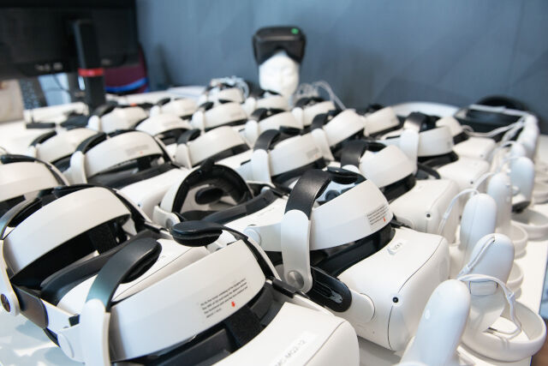
Plenary
Reflect on results
Key observations and considerations
Wrap Up

Slide 41
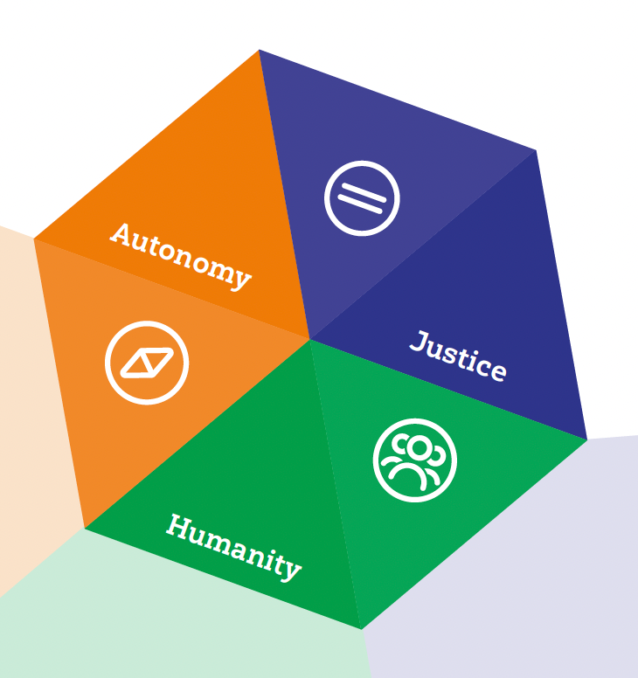
Understanding Public Values
Public values are core principles that serve the common good and help protect our members’ interests.
These values are talked about on many levels such as strategy, design, and technology use.
In this game, players will think about how these values are affected by XR in education.
Learn more at https://www.surf.nl/themas/publieke-waarden

Slide 42

Responsible XR Resources
Responsible XR Pleio Community page:
  https://edu.nl/yc4wq
Public values for XR in education and research
  https://edu.nl/vxewe
SURFsounds special: tussen macht en moraal afl.1 Wat ging er mis
  https://edu.nl/fc6cr
Our report on Responsible Tech (eng/nl)
  https://edu.nl/6hyrt

